Slide 1
William Stallings
Data and Computer Communications
7th Edition
Chapter 11
Asynchronous Transfer Mode

Slide 2
Protocol Architecture
Similarities between ATM and packet switching
  Transfer of data in discrete chunks
  Multiple logical connections over single physical interface
In ATM flow on each logical connection is in fixed sized packets called cells
Minimal error and flow control
  Reduced overhead
Data rates (physical layer) 25.6Mbps to 622.08Mbps

Slide 3
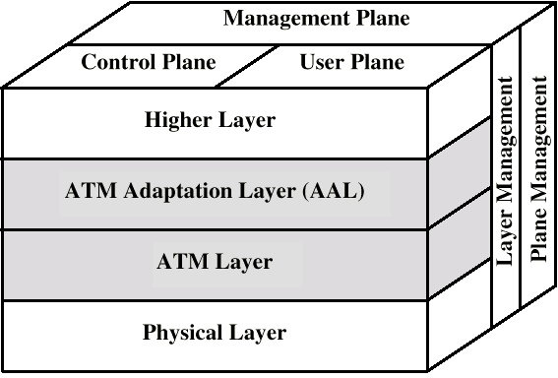
Protocol Architecture (diag)

Slide 4
Reference Model Planes
User plane
  Provides for user information transfer
Control plane
  Call and connection control
Management plane
  Plane management
    whole system functions
  Layer management
    Resources and parameters in protocol entities

Slide 5
ATM Logical Connections
Virtual channel connections (VCC)
Analogous to virtual circuit in X.25
Basic unit of switching
Between two end users
Full duplex
Fixed size cells
Data, user-network exchange (control) and network-network exchange (network management and routing)
Virtual path connection (VPC)
  Bundle of VCC with same end points

Slide 6
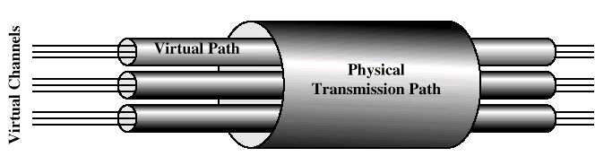
ATM Connection Relationships

Slide 7
Advantages of Virtual Paths
Simplified network architecture
Increased network performance and reliability
Reduced processing
Short connection setup time
Enhanced network services

Slide 8
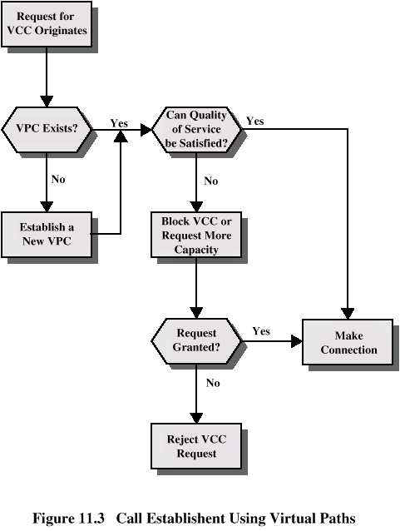
Call
Establishment
Using VPs

Slide 9
Virtual Channel Connection Uses
Between end users
  End to end user data
  Control signals
  VPC provides overall capacity
    VCC organization done by users
Between end user and network
  Control signaling
Between network entities
  Network traffic management
  Routing

Slide 10
VP/VC Characteristics
Quality of service
Switched and semi-permanent channel connections
Call sequence integrity
Traffic parameter negotiation and usage monitoring
VPC only
  Virtual channel identifier restriction within VPC

Slide 11
Control Signaling - VCC
Done on separate connection
Semi-permanent VCC
Meta-signaling channel
  Used as permanent control signal channel
User to network signaling virtual channel
  For control signaling
  Used to set up VCCs to carry user data
User to user signaling virtual channel
  Within pre-established VPC
  Used by two end users without network intervention to establish and release user to user VCC

Slide 12
Control Signaling - VPC
Semi-permanent
Customer controlled
Network controlled

Slide 13
ATM Cells
Fixed size
5 octet header
48 octet information field
Small cells reduce queuing delay for high priority cells
Small cells can be switched more efficiently
Easier to implement switching of small cells in hardware

Slide 14
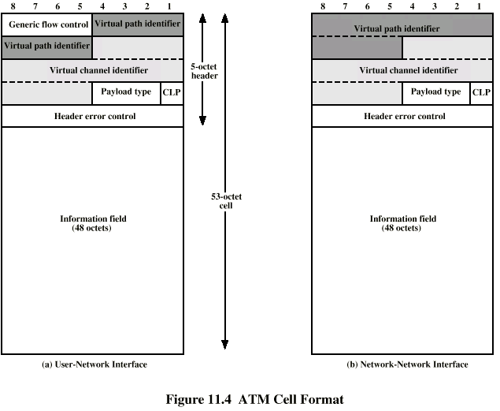
ATM Cell Format

Slide 15
Header Format
Generic flow control
  Only at user to network interface
  Controls flow only at this point
Virtual path identifier
Virtual channel identifier
Payload type
  e.g. user info or network management
Cell loss priority
Header error control

Slide 16
Generic Flow Control (GFC)
Control traffic flow at user to network interface (UNI) to alleviate short term overload
Two sets of procedures
  Uncontrolled transmission
  Controlled transmission
Every connection either subject to flow control or not
Subject to flow control
  May be one group (A) default
  May be two groups (A and B)
Flow control is from subscriber to network
  Controlled by network side

Slide 17
Single Group of Connections (1)
Terminal equipment (TE) initializes two variables
  TRANSMIT flag to 1
  GO_CNTR (credit counter) to 0
If TRANSMIT=1 cells on uncontrolled connection may be sent any time
If TRANSMIT=0 no cells may be sent (on controlled or uncontrolled connections)
If HALT received, TRANSMIT set to 0 and remains until NO_HALT

Slide 18
Single Group of Connections (2)
If TRANSMIT=1 and no cell to transmit on any uncontrolled connection:
  If GO_CNTR>0, TE may send cell on controlled connection
    Cell marked as being on controlled connection
    GO_CNTR decremented
  If GO_CNTR=0, TE may not send on controlled connection
TE sets GO_CNTR to GO_VALUE upon receiving SET signal
  Null signal has no effect

Slide 19
Use of HALT
To limit effective data rate on ATM
Should be cyclic
To reduce data rate by half, HALT issued to be in effect 50% of time
Done on regular pattern over lifetime of connection

Slide 20
Two Queue Model
Two counters
  GO_CNTR_A, GO_VALUE_A,GO_CNTR_B, GO_VALUE_B

Slide 21
Header Error Control
8 bit error control field
Calculated on remaining 32 bits of header
Allows some error correction

Slide 22
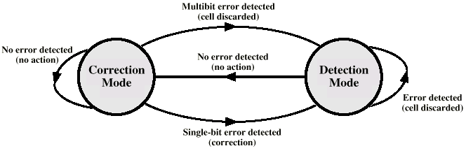
HEC Operation at Receiver

Slide 23
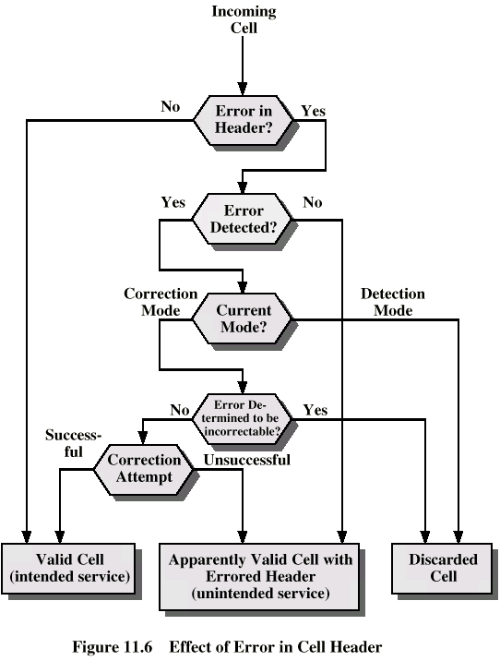
Effect of
Error in
Cell Header

Slide 24
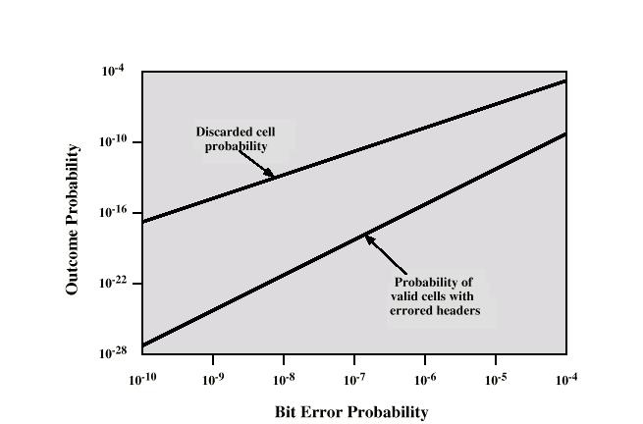
Impact of Random Bit Errors on HEC Performance

Slide 25
Transmission of ATM Cells
622.08Mbps
155.52Mbps
51.84Mbps
25.6Mbps
Cell Based physical layer
SDH based physical layer

Slide 26
Cell Based Physical Layer
No framing imposed
Continuous stream of 53 octet cells
Cell delineation based on header error control field

Slide 27
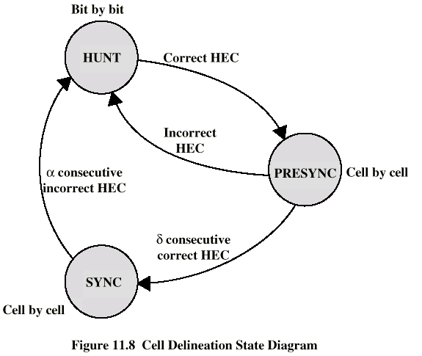
Cell Delineation State Diagram

Slide 28
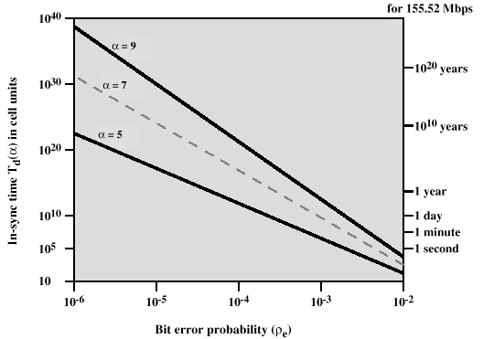
Impact of Random Bit Errors on Cell Delineation Performance

Slide 29
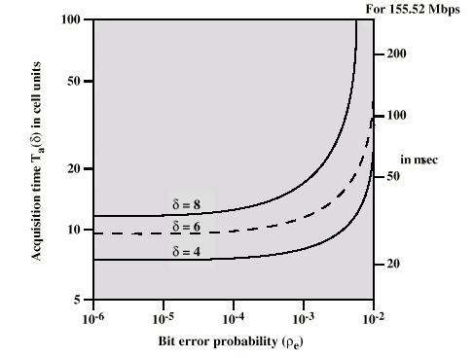
Acquisition Time v Bit Error Rate

Slide 30
SDH Based Physical Layer
Imposes structure on ATM stream
e.g. for 155.52Mbps
Use STM-1 (STS-3) frame
Can carry ATM and STM payloads
Specific connections can be circuit switched using SDH channel
SDH multiplexing techniques can combine several ATM streams

Slide 31
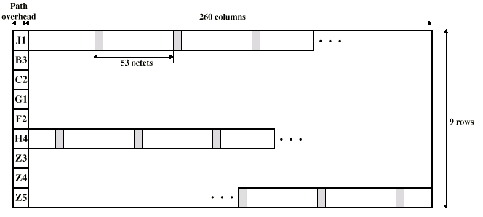
STM-1 Payload for SDH-Based ATM Cell Transmission

Slide 32
ATM Service Categories
Real time
  Constant bit rate (CBR)
  Real time variable bit rate (rt-VBR)
Non-real time
  Non-real time variable bit rate (nrt-VBR)
  Available bit rate (ABR)
  Unspecified bit rate (UBR)
  Guaranteed frame rate (GFR)

Slide 33
Real Time Services
Amount of delay
Variation of delay (jitter)

Slide 34
CBR
Fixed data rate continuously available
Tight upper bound on delay
Uncompressed audio and video
  Video conferencing
  Interactive audio
  A/V distribution and retrieval

Slide 35
rt-VBR
Time sensitive application
  Tightly constrained delay and delay variation
rt-VBR applications transmit at a rate that varies with time
e.g. compressed video
  Produces varying sized image frames
  Original (uncompressed) frame rate constant
  So compressed data rate varies
Can statistically multiplex connections

Slide 36
nrt-VBR
May be able to characterize expected traffic flow
Improve QoS in loss and delay
End system specifies:
  Peak cell rate
  Sustainable or average rate
  Measure of how bursty traffic is
e.g. Airline reservations, banking transactions

Slide 37
UBR
May be additional capacity over and above that used by CBR and VBR traffic
  Not all resources dedicated
  Bursty nature of VBR
For application that can tolerate some cell loss or variable delays
  e.g. TCP based traffic
Cells forwarded on FIFO basis
Best efforts service

Slide 38
ABR
Application specifies peak cell rate (PCR) and minimum cell rate (MCR)
Resources allocated to give at least MCR
Spare capacity shared among all ARB sources
e.g. LAN interconnection

Slide 39
Guaranteed Frame Rate (GFR)
Designed to support IP backbone subnetworks
Better service than UBR for frame based traffic
  Including IP and Ethernet
Optimize handling of frame based traffic passing from LAN through router to ATM backbone
  Used by enterprise, carrier and ISP networks
  Consolidation and extension of IP over WAN
ABR difficult to implement between routers over ATM network
GFR better alternative for traffic originating on Ethernet
  Network aware of frame/packet boundaries
  When congested, all cells from frame discarded
  Guaranteed minimum capacity
  Additional frames carried of not congested

Slide 40
ATM Adaptation Layer
Support for information transfer protocol not based on ATM
PCM (voice)
  Assemble bits into cells
  Re-assemble into constant flow
IP
  Map IP packets onto ATM cells
  Fragment IP packets
  Use LAPF over ATM to retain all IP infrastructure

Slide 41
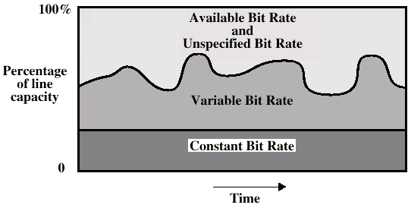
ATM Bit Rate Services

Slide 42
Adaptation Layer Services
Handle transmission errors
Segmentation and re-assembly
Handle lost and misinserted cells
Flow control and timing

Slide 43
Supported Application types
Circuit emulation
VBR voice and video
General data service
IP over ATM
Multiprotocol encapsulation over ATM (MPOA)
  IPX, AppleTalk, DECNET)
LAN emulation

Slide 44
AAL Protocols
Convergence sublayer (CS)
  Support for specific applications
  AAL user attaches at SAP
Segmentation and re-assembly sublayer (SAR)
  Packages and unpacks info received from CS into cells
Four types
  Type 1
  Type 2
  Type 3/4
  Type 5

Slide 45
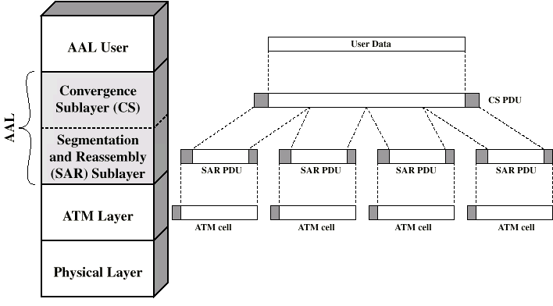
AAL Protocols

Slide 46
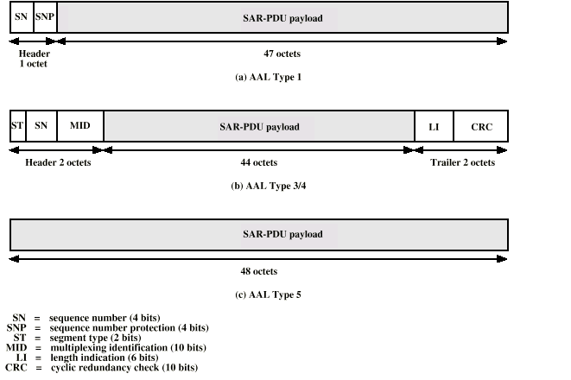
Segmentation and Reassembly PDU

Slide 47
AAL Type 1
CBR source
SAR packs and unpacks bits
Block accompanied by sequence number

Slide 48
AAL Type 2
VBR
Analog applications

Slide 49
AAL Type 3/4
Connectionless or connected
Message mode or stream mode

Slide 50
AAL Type 5
Streamlined transport for connection oriented higher layer protocols

Slide 51
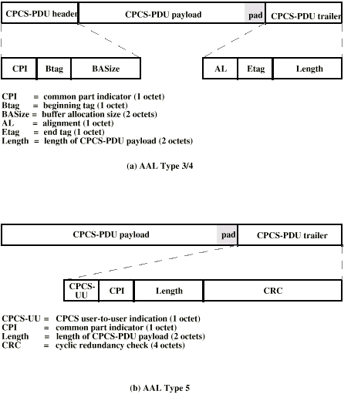
CPCS PDUs

Slide 52
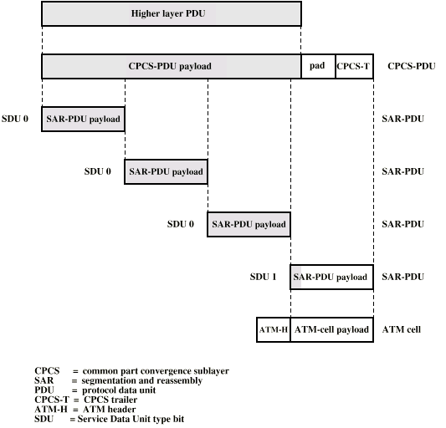
Example AAL 5 Transmission

Slide 53
Required Reading
Stallings Chapter 11
ATM Forum Web site

